Slide 1

Chapter 1
Introduction
1.<number>
Copyright © The McGraw-Hill Companies, Inc. Permission required for reproduction or display.
Notes:
1.#

Slide 2
1-1 DATA COMMUNICATIONS
Local /remote communication
Data refers to information presented in whatever form is agreed upon by the parties creating and using the data.
Data communications - Exchange of data between two devices via some form of transmission medium.
Effectiveness of data communication depends on :
Delivery
Accuracy
Timeliness(real time)
Jitter- variation in packet arrival time
1.<number>
Notes:
1.#

Slide 3

1.1.1 Components of Data Communication System
Message - Information (data) to be communicated.
Sender - Device that sends the data message.
Receiver -Device that receives the message.
Transmission medium - Physical path by which a message travels from sender to receiver.
Protocol- Set of rules that govern data communications. It represents an agreement between the communicating devices. Without a protocol, two devices may be connected but not communicating.
1.<number>

Slide 4
1.1.2 Data Representation
Text (coding)
Numbers
Images
Audio – continuous signal
Video – continuous or combination of images
1.<number>

Slide 5

1.1.3 Data Flow
Simplex
  Keyboard
Half Duplex
  Pc to printer
Full Duplex
  Two lane highway, telephone lines
1.<number>

Slide 6

Figure 1.2 Data flow (simplex, half-duplex, and full-duplex)
1.<number>
Notes:
1.#

Slide 7
1-2 NETWORKS
A network is an interconnection set of devices (often referred to as nodes) connected by communication links.
Nodes - ?
Links- ?
Topics discussed in this section:
1.2.1 Network Criteria
1.2.2 Physical Structures / Topologies
1.<number>
Notes:
1.#

Slide 8
1.2.1 Network Criteria
Performance
  Depends on Network Elements
  Measured by transit time and response time
  Measured in terms of Delay and Throughput
Reliability
  Failure rate of network components
  Measured in terms of availability/robustness in catastrophe
Security
  Data protection against corruption/loss of data due to:
      Errors
      Malicious users
1.<number>
Notes:
1.#

Slide 9

1.2.2 Physical Structures- Network Attributes
Type of Connection
  Point to Point - single transmitter and receiver(remote and TV). Channel capacity is reserved.
  Multipoint/ multidrop - multiple recipients of single transmission. Channel capacity may be spatially or temporally.
1.<number>
Notes:
1.#

Slide 10

Physical Topology- network is laid out physically. Representation of relationship
  Connection of devices
  Type of transmission - unicast, broadcast
1.<number>
Notes:
1.#

Slide 11

Figure 1.5 A fully connected mesh topology (five devices)
Total number of physical connections: ?
Total number of duplex mode links ?
Eliminating the traffic problems
A robust topology.
Advantage of privacy and security.
Fault identification
Cabling and number of ports.
Installation and reconnection.
Sheer bulk of wiring.
Expensive.
E.g Telephone Regional Office.
1.<number>
Notes:
1.#

Slide 12

Figure 1.6 A star topology connecting four stations
Less expensive than mesh.
Easy to install and configure.
Less cabling.
Robustness.
Easy fault identification and fault isolation.
Dependency issues.
More cabling as compare to other topologies except mesh.
Mostly used in LAN.
1.<number>
Notes:
1.#

Slide 13

Figure 1.7 A bus topology connecting three stations
Multipoint connections.
Ease of installation.
Less cabling than mesh or star.
Long wired backbone may be weak due to heat.
Difficulty in reconnection and fault isolation.
Signal degradation at taps.
Adding new devices require modification.
Fault and break.
Noise while reflection of signal back to backbone.
Less popular.
1.<number>
Notes:
1.#

Slide 14

Figure 1.8 A ring topology connecting six stations
Dedicated point to point connections.
Signal pass in one direction.
Easy to install and reconfigure.
Fault isolation is simplified.
Alarm issuing is there.
Unidirectional traffic.
Dependency.
1.<number>
Notes:
1.#

Slide 15

Figure 1.9 A hybrid topology: a star backbone with three bus networks
1.<number>
Notes:
1.#

Slide 16
Categories of Networks
Local Area Networks (LANs)
  Short distances
  Designed to provide local interconnectivity
  Interconnects the hosts
Wide Area Networks (WANs)
  Long distances
  Provide connectivity over large areas
  Interconnects the cities/ towns, state, countries
Metropolitan Area Networks (MANs)
  Provide connectivity over areas such as a city, a campus
1.<number>
Notes:
1.#

Slide 17
LAN
Local Area Network
1.Covers a small region of space, typically a single building.
Smallest network
Simplest form of LAN is to connect two computers together
4. LAN is operated within a limited physical area such as at home, school, a single building or several buildings.
5. A network which consists of less than 500 interconnected devices across several buildings, is still recognized as a LAN.
6. LAN is very high speed network (from previously 10Mbps) to 100Mbps,which is faster than MAN and WAN.

Slide 18
MAN
Metropolitan Area Network
1. Is collection of LANs with the same geographical area, for instance a city.
2. Is a network of computers located at different sites within a large physical area, such as a city.
3. MAN often acts as a high speed network(although not as fast as LAN) to allow sharing of regional resources.
4. MAN can defined as a group of computers and network devices connected together within a large physical area.
5. Companies that have several branches within the kuala lumpur city such as banks, might find a MAN useful to them.

Slide 19

Figure 1.10 An isolated LAN connecting 12 computers to a hub in a closet
1.<number>
Notes:
1.#

Slide 20
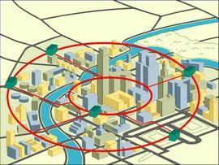
MAN

Slide 21
WAN
Wide Area Network
1. Is the largest network of all network types.
2. The internet is the largest WAN in the world.
3. WAN generally covers large distances such as states, countries or continents.
4. WAN is group of MANs or LANs or the mixture of both network.
5. An example in the society using WAN is the banking organization.

Slide 22
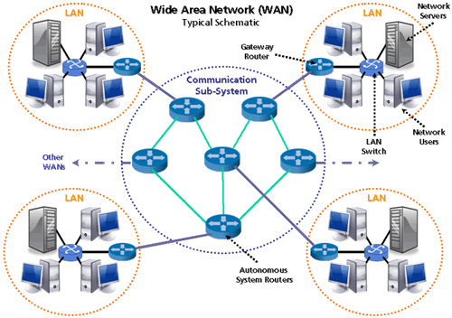
WAN

Slide 23
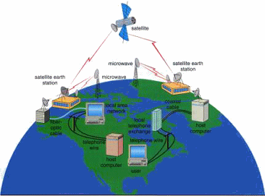
WAN

Slide 24
Differences between Types of Computer Networks
Criteria
LAN
MAN
WAN
Cost
Low
High
Higher
Network Size
Small
Larger
Largest
Speed
Fastest
Faster
Fast
Transmission Media Type
Twisted-Pair
Twisted-Pair and Fibre-Optic
Fibre-Optic, radio wave and satellite
Number of computer
Smallest
Large
Largest

Slide 25

Figure 1.11 WANs: a switched WAN and a point-to-point WAN
1.<number>
Notes:
1.#

Slide 26

Figure 1.12 A heterogeneous network made of four WANs and two LANs
1.<number>
Notes:
1.#

Slide 27
1-3 THE INTERNET
The internetwork or Internet has revolutionized many aspects of our daily lives. It has affected the way we do business as well as the way we spend our leisure time. The Internet is a communication system that has brought a wealth of information to our fingertips and organized it for our use.
Internet is a switched network.
Topics discussed in this section:
Accessing the Internet
Internet Service Providers (ISPs)
1.<number>
Notes:
1.#

Slide 28
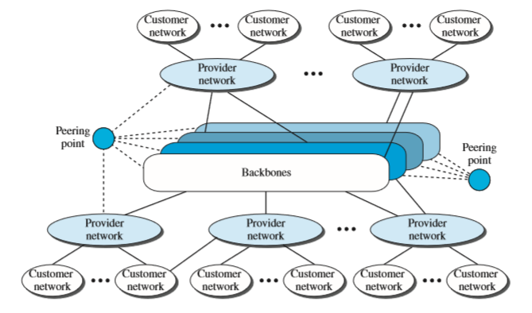

Internet Today
1.<number>
Notes:
Spectranet local isp
1.#

Slide 29
1-4 PROTOCOLS
A protocol is synonymous with rule. It consists of a set of rules that govern data communications. It determines what is communicated, how it is communicated and when it is communicated. The key elements of a protocol are syntax, semantics and timing
1.<number>
Notes:
1.#

Slide 30
_x0010_Elements of a Protocol
Syntax
  Structure or format of the data
  Indicates how to read the bits
  Semantics
  Interprets the meaning of the bits
  Knows which fields define what action
Timing
  When data should be sent and what
  Speed at which data should be sent or speed at which it is being received.
1.<number>
Notes:
1.#

